Slide 1



Healthcare IoT Monitoring Platform
SIC 8
BD Course
G 20
Notes:
Note:
1

Slide 2

Agenda
Team
Introduction
Problem Statement
Methodology
Key Tasks
Results and Insights
Conclusion
Samsung Innovation Campus
Notes:
Note:
2

Slide 3

Team
  Retage Wael Data Ingestion
  Yousef Michael Data Transformation, Data Orchestration
  Mohamed Sherif Data Warehousing, Data Orchestration
  Amr Metwally BI & Analytics Integration
Samsung Innovation Campus
Notes:
Note:
4

Slide 4
Agenda
Team
Introduction
Problem Statement
Methodology
Key Tasks
Results and Insights
Conclusion
Samsung Innovation Campus
Notes:
Note:
3

Slide 5
Introduction
Connecting Patient Care to Actionable Insights
THE CONTEXT
Continuous Hospital Stream
Modern wards rely on continuous telemetry from smart bedside monitors, heart-rate sensors, and oxygen meters.
PROJECT OBJECTIVE
Reliable Real-Time Data Streaming
Build a high-availability pipeline that captures live patient telemetry without data loss, streaming seamlessly from devices to cloud storage for instant analysis.
BUSINESS VALUE
Clinical Efficiency & Safety
Eliminates critical alert lags, optimizes bed management, and protects hospital reputation with 100% data auditability.
Samsung Innovation Campus
Notes:
Note:
4

Slide 6
Agenda
Team
Introduction
Problem Statement
Key Tasks
Methodology
Results and Insights
Conclusion
Samsung Innovation Campus
Notes:
Note:
5

Slide 7
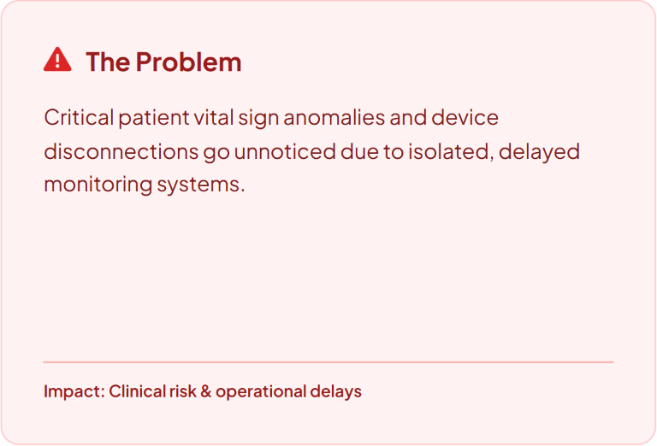
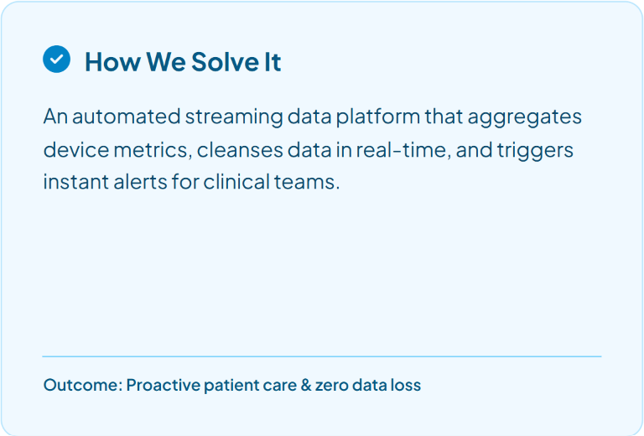
Problem Statement
  Solving Real-Time Hospital Patient Monitoring
Samsung Innovation Campus
Notes:
Note:
6

Slide 8
Agenda
Team
Introduction
Problem Statement
Methodology
Key Tasks
Results and Insights
Conclusion
Samsung Innovation Campus
Notes:
Note:
7

Slide 9
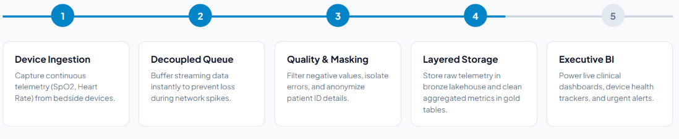

METHODOLOGY
  End-to-End Implementation Workflow
Samsung Innovation Campus
Notes:
Note:
6

Slide 10
Agenda
Team
Introduction
Problem Statement
Methodology
Key Tasks
Results and Insights
Conclusion
Q&A
Samsung Innovation Campus
Notes:
Note:
8

Slide 11

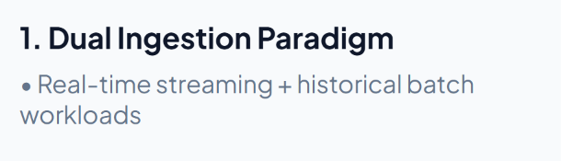
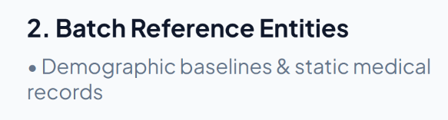
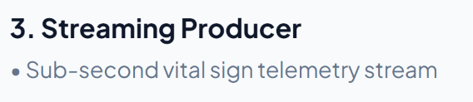
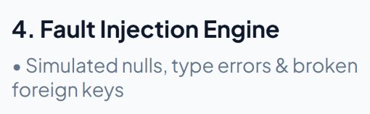
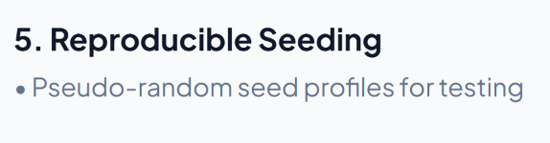
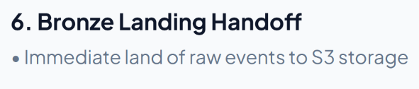
Data Generation

Slide 12
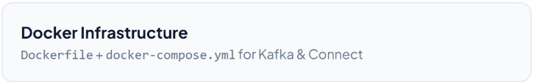
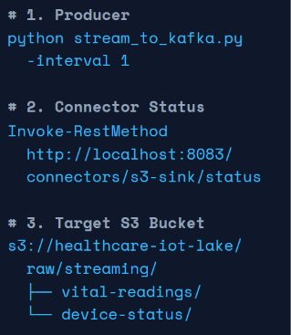
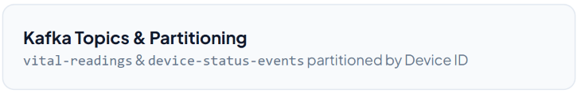
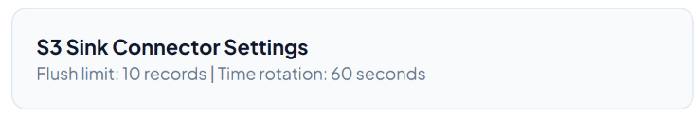

Data Ingestion
Streaming Ingestion Engine (Kafka to S3)

Slide 13
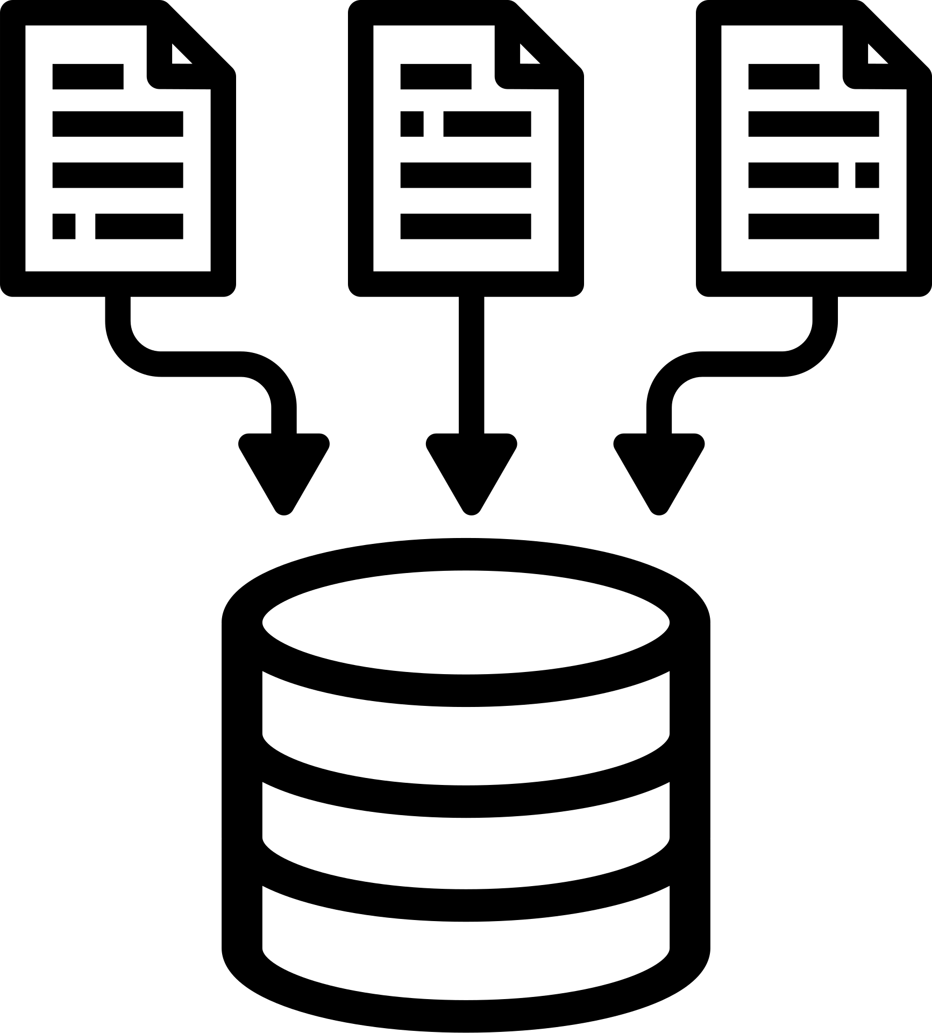
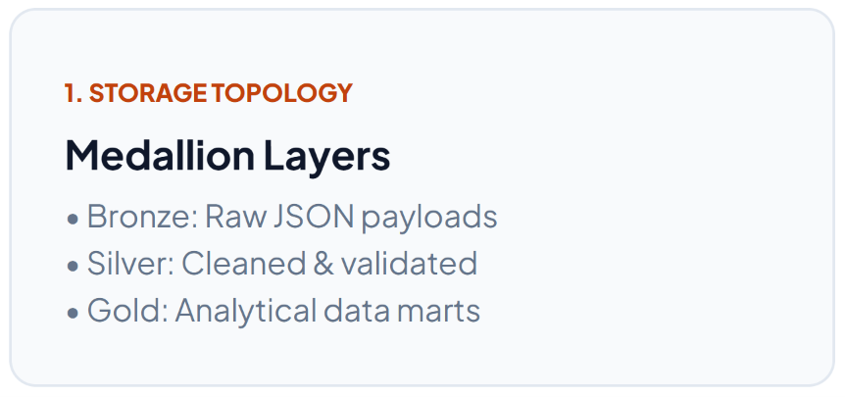
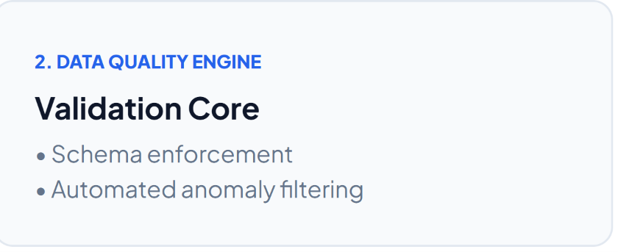
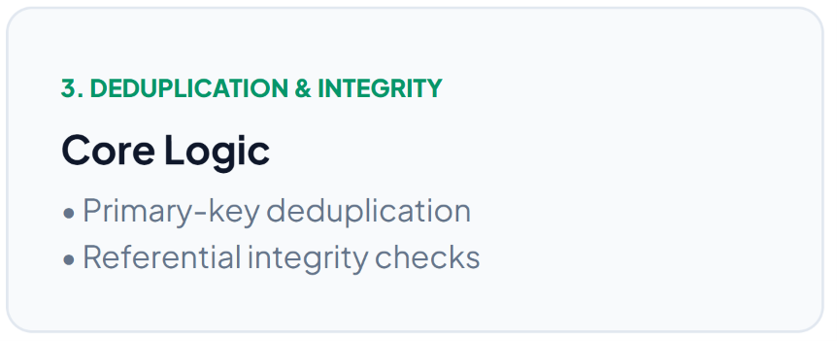
Data Transformation
Lakehouse Architecture & Early Validation

Slide 14
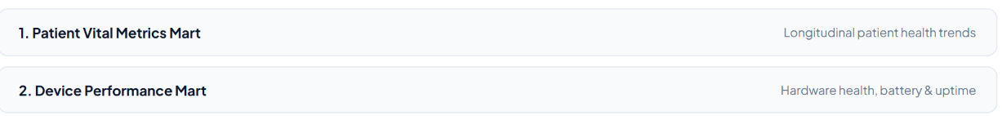
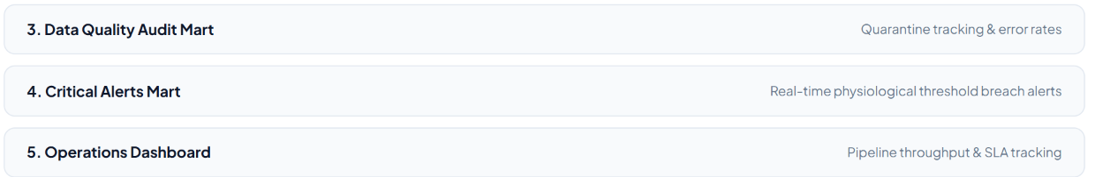
Data Transformation
Silver-to-Gold Analytical Marts (5 Datasets)

Slide 15
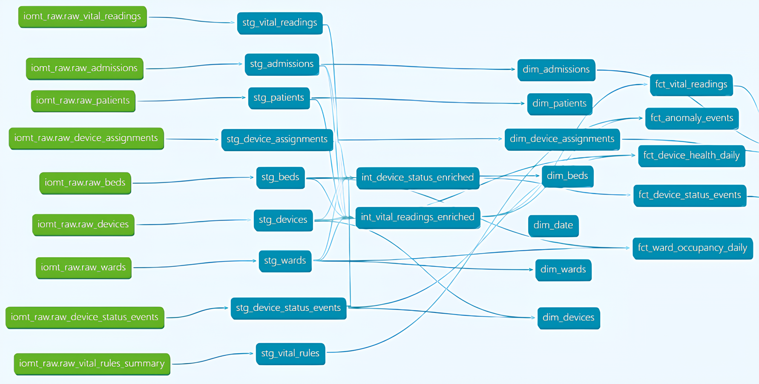
Data Warehouse
From Silver to Snowflake with dbt
S3 Silver
9
Parquet datasets
RAW
9
tables loaded as-is
STAGING
9
clean typed views
INTERMEDIATE
2
context-enriched views
MARTS
12
7 dimensions + 5 facts

Slide 16
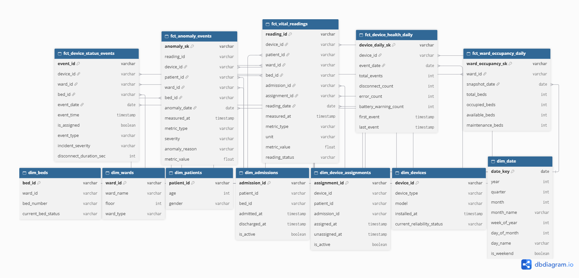
Data Warehouse
Galaxy Schema for Device Analytics
5 facts share 7 dimensions
Point-in-time context
UNKNOWN rows

Slide 17

Data Warehouse
What the Warehouse Answers
Which devices disconnect most, and in which bed?
Device events and daily device health | Biomedical engineering
Which readings breach a threshold, and how severe?
Threshold alerts | Authorised monitoring staff
Where did a device go quiet while on a patient?
Readings with missing values | Operations
How full is each ward?
Daily occupancy snapshot | Hospital management

Slide 18
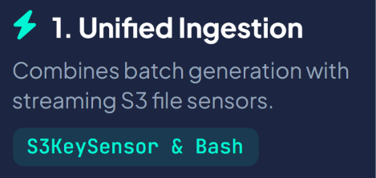
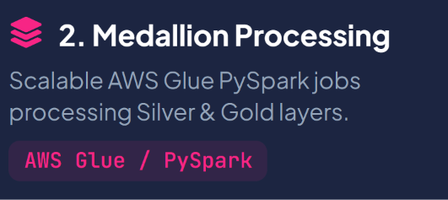
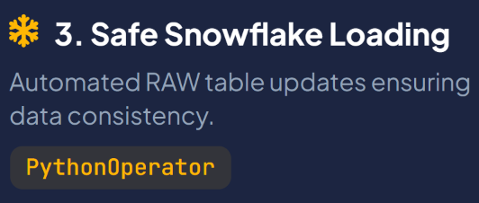
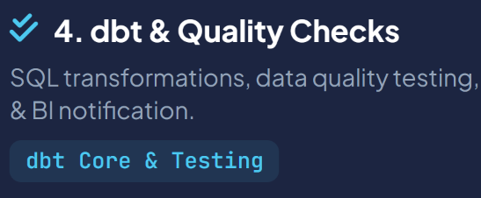
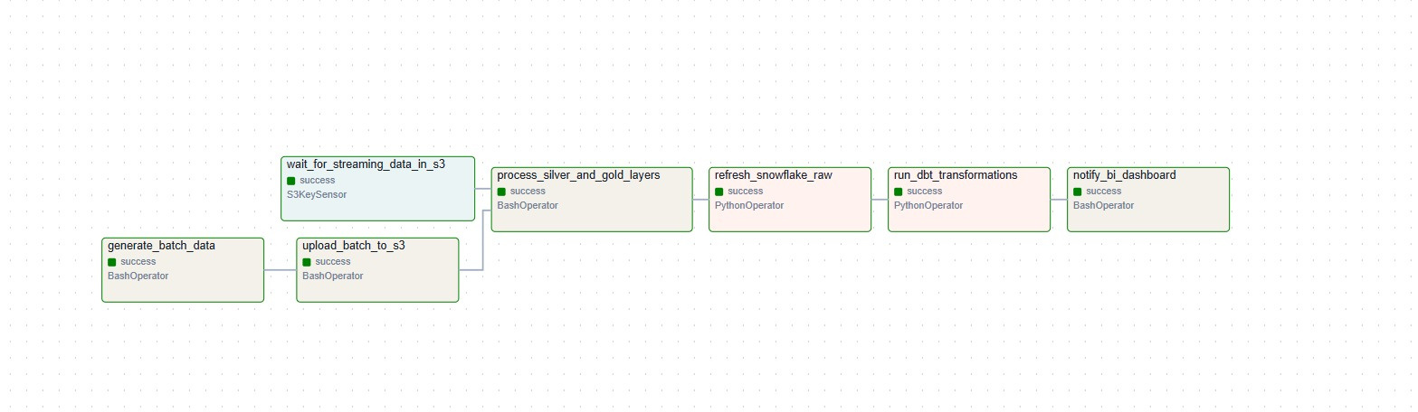

Data Pipeline Orchestration

Slide 19
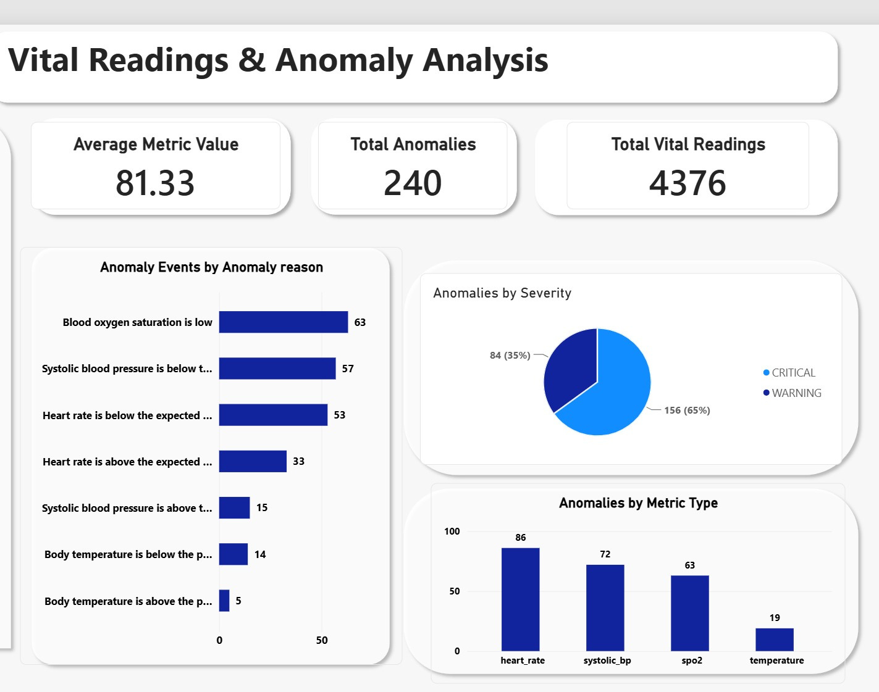
Dashboard

Slide 20
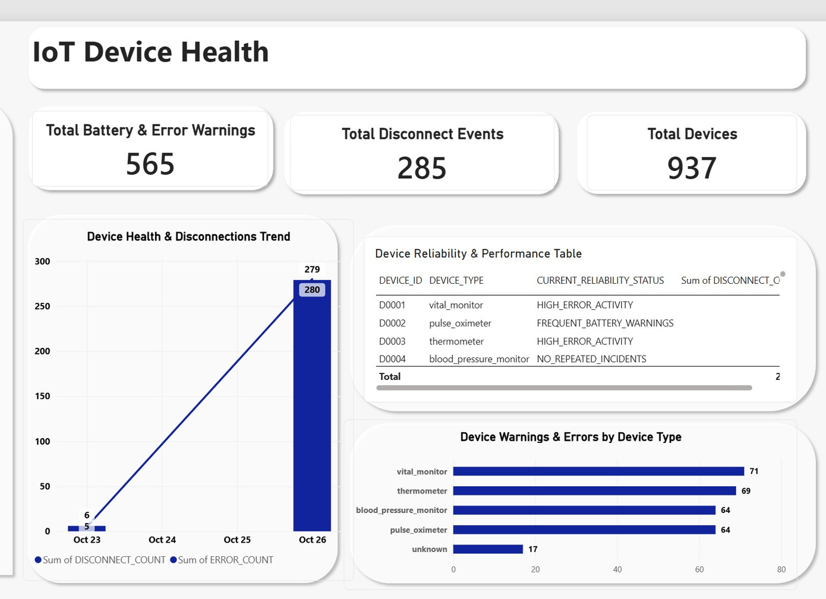
Dashboard

Slide 21
Agenda
Team
Introduction
Problem Statement
Methodology
Key Tasks
Recommendation
Conclusion
Samsung Innovation Campus
Notes:
Note:
8

Slide 22
Recommendation
  Prioritize Maintenance for High-Risk Telemetry Devices
  Resolve IoT Connectivity & Telemetry Signal Drops
  Automate Alert Escalations for Low Oxygen & Abnormal Blood Pressure
Samsung Innovation Campus
Notes:
Note:
6

Slide 23
Agenda
Team
Introduction
Problem Statement
Methodology
Key Tasks
Recommendation
Conclusion
Samsung Innovation Campus
Notes:
Note:
8

Slide 24

Pipeline Conclusion & Core Engineering Value
  Complete End-to-End Lifecycle: Demonstrates a full data engineering pipeline—from synthetic IoT data generation, batch & streaming ingestion, and Lakehouse storage to Snowflake loading, dbt transformations, and Power BI dashboards.
  Traceability & Automated Quality Gates: Integrates distributed pipeline stages with strict data quality testing and workflow orchestration, ensuring end-to-end data integrity across every layer.
  Focus on Data Engineering Excellence: The core value lies in reliable data movement, distributed validation, and seamless pipeline integration rather than clinical data interpretation.
Samsung Innovation Campus
Notes:
Note:
6

Slide 25


Samsung Innovation Campus
Notes:
Note:
8

Slide 26

ⓒ2020 SAMSUNG. All rights reserved.
Samsung Electronics Corporate Citizenship Office holds the copyright of book.
This book is a literary property protected by copyright law so reprint and reproduction without permission are prohibited.
To use this book other than the curriculum of Samsung innovation Campus or to use the entire or part of this book, you must receive written consent from copyright holder.
Notes:
10

